Slide 1
Analyzing Amazon Sales Data Analysis
Presented by: Aditya Raj
Company: Unified Mentor
Project: 1st

Slide 2
Table of contents
01
02
03
04
Introduction
05
Dashboarding
Objective & Problem statement
06
Profitable Insights
Data validation &
Transformation
07
Conclusion
Data Insertion
08
Recommendations:

Slide 3
Introduction
Sales management has become increasingly crucial in today's highly competitive business environment. As markets grow more saturated and customers demand more personalized experiences, businesses must adopt sophisticated strategies to maintain and grow their market share. Effective sales management not only enhances the efficiency of distribution channels, reducing costs and improving margins, but also plays a vital role in driving overall business profitability. By strategically aligning sales efforts with broader business objectives, companies can ensure that they are not just meeting but exceeding customer expectations. This, in turn, leads to stronger customer relationships, higher sales volumes, and sustained competitive advantage. The role of sales management has evolved from simply overseeing a team of salespeople to being a central function that integrates with marketing, finance, and operations to optimize the entire sales process. In essence, sales management is now the cornerstone of any successful commercial enterprise, driving growth and ensuring long-term success.

Slide 4
Objective
The objective of this project is to analyze Amazon sales data to uncover key trends, metrics, and relationships between various attributes. By leveraging Python for data processing and Power BI for visualization, the project aims to provide actionable insights into sales performance, customer behavior, and product success, thereby enabling informed decision-making to drive business growth.

Slide 5
Problem Statement
With the vast amount of sales data generated on Amazon, businesses face challenges in extracting meaningful insights that can guide strategic decisions. This project seeks to address these challenges by conducting a comprehensive analysis of Amazon sales data. The analysis will focus on identifying sales trends on a month-wise, year-wise, and yearly-month-wise basis, as well as uncovering key metrics and factors that influence sales. The goal is to reveal patterns and correlations that can help optimize sales strategies, improve customer targeting, and enhance overall business performance.

Slide 6
Data validation & Transformation
Understanding data distribution, pattern and anomalies
Data Cleaning, handle missing values, remove duplicate and filter out irrelevant data
Normalization and Standardization of data
No null value detected in dataset “If there are any duplicate values we use pf.dropna()”
no duplicate rows are found in dataset “if we found duplicate values we use df.drop_duplicate()”
Found Ship Date and Order Date as object data type “Changing this object to date data type”
df.describe() give all infomation about count, mean value, standard deviation min value, 25%, 50%, 75%, max value

Slide 7
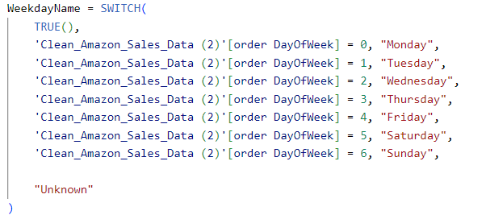
Data Insertion
The initial data set was insufficient for analyzing crop production trends and generating insights.
Additional columns were introduced to enhance the analysis.
A “WeekdayName” column is add by using DAX formula

Slide 8
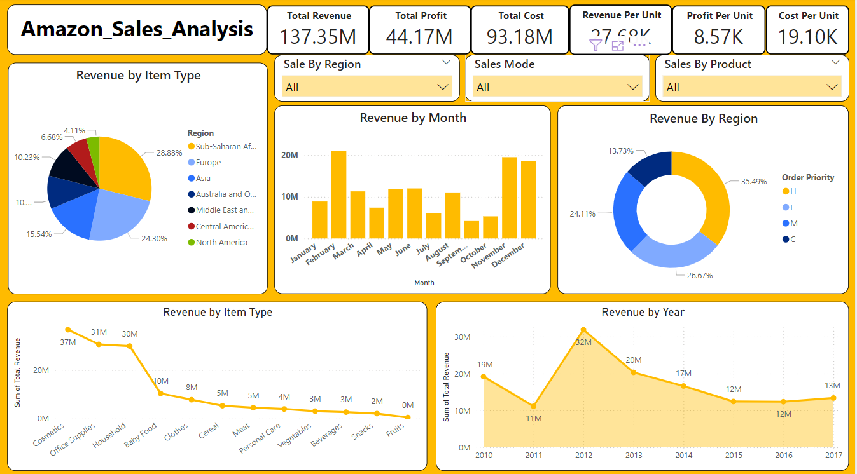
Dashboarding
Revenue Analysis Dashboard

Slide 9
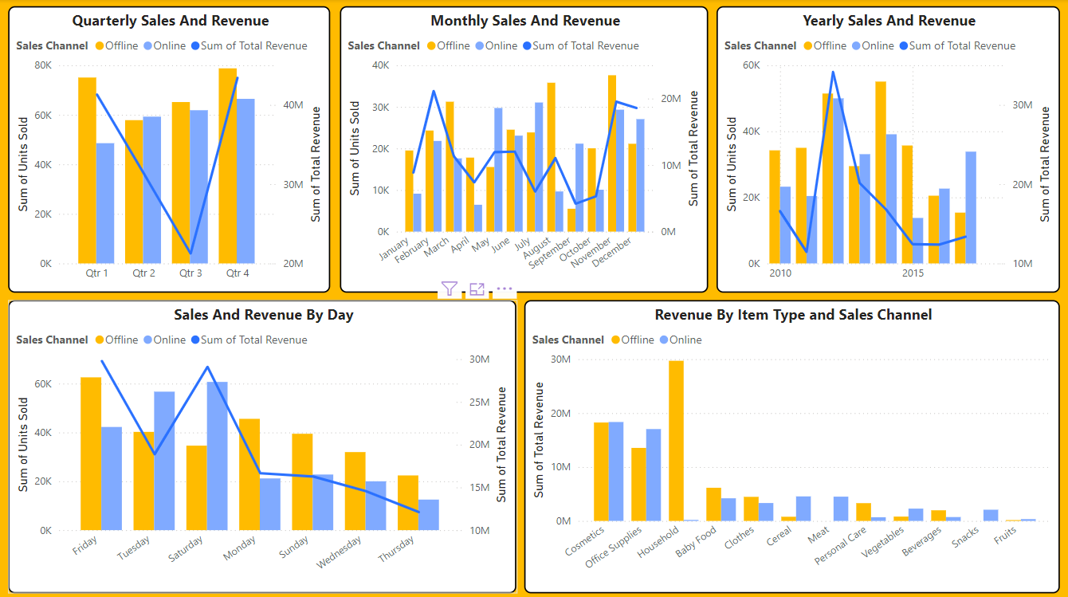
Dashboarding
Sales Channel Dashboard

Slide 10
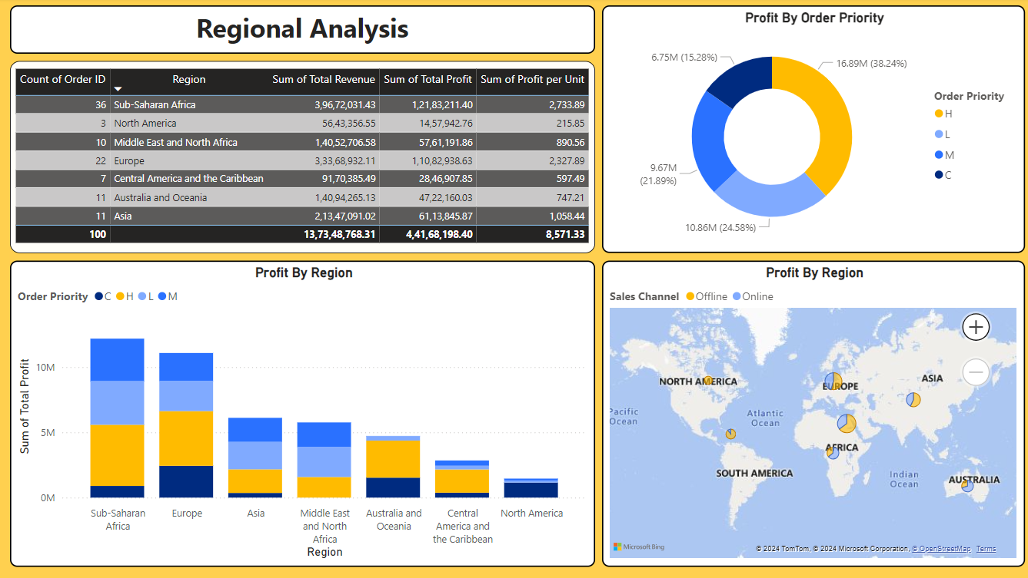
Dashboarding
Reginal Analysis Dashboard

Slide 11
Profitable insights
1. Overall Performance:
Total Revenue: $137.35M
Total Profit: $44.17M
Total Cost: $93.18M
Revenue Per Unit: $27.68K
Profit Per Unit: $8.57K
Cost Per Unit: $19.10K
2. Revenue by Item Type:
Top Contributors:
Household: $31M
Baby Food: $30M
Cosmetics: $37M
Lower Performers:
Personal Care, Vegetables, Beverages, Snacks, Fruits: All these categories contribute minimally to the total revenue, indicating they may not be key drivers of sales.
3. Revenue by Region:
Top-Performing Regions:
Sub-Saharan Africa: $39.67M (28.88%)
Europe: $33.68M (24.30%)
North America: $56.43M (35.49%)
Lower Performing Regions:
Central America and the Caribbean: $91.70M (6.68%)
Australia and Oceania: $14.09M (4.11%)

Slide 12
Profitable insights
4. Revenue by Month:
Peak Months:
December: $20M
January: $20M
October: $18M
Low Months:
February, March, April, May, June, July, August, September: All these months have relatively lower revenue.
5. Sales Channel Analysis:
Online vs Offline:
Online Sales: Generally higher than offline in terms of revenue.
Offline Sales: Lagging behind online, especially noticeable in the "Revenue by Item Type and Sales Channel" analysis.
6. Sales and Revenue by Quarter:
Q3 and Q4: Highest revenue and sales, indicating strong performance in the second half of the year.
Q1: Noticeable dip in revenue, indicating weaker sales.
7. Sales and Revenue by Day:
Peak Days:
Friday: High sales and revenue.
Lowest Days:
Monday and Wednesday: Lower sales and revenue.

Slide 13
Conclusion
﻿At 3,66,01,509.60, Cosmetics had the highest Sum of Total Revenue and was 7,746.30% higher than Fruits, which had the lowest Sum of Total Revenue at 4,66,481.34.﻿﻿
﻿﻿Cosmetics accounted for 26.65% of Sum of Total Revenue.﻿﻿
﻿﻿Sum of Total Revenue trended down, resulting in a 30.30% decrease between 2010 and 2017.﻿﻿
﻿﻿Sum of Total Revenue started trending down on 2010, falling by 30.30% (58,12,605.29) in 7 years.﻿﻿
﻿﻿Across all 12 Month, Sum of Total Revenue ranged from 41,88,045.51 to 2,11,05,331.41.﻿
﻿Total Sum of Units Sold was higher for Offline (276782) than Online (236089).﻿﻿
﻿﻿Qtr 4 in Sales Channel Offline made up 15.35% of Sum of Units Sold.﻿﻿
﻿﻿Average Sum of Units Sold was higher for Offline (69,195.50) than Online (59,022.25).﻿﻿
﻿﻿Sum of Units Sold for Offline and Online diverged the most when the Month was August, when Offline were 26148 higher than Online.﻿﻿
﻿H had the highest total Sum of Total Profit at 1,68,91,599.58, followed by L, M, and C.﻿﻿
﻿﻿Sub-Saharan Africa in Order Priority H made up 10.61% of Sum of Total Profit.﻿﻿

Slide 14
Recommendations:
Focus on High Revenue Months: Target marketing and sales efforts during December and January, which are the peak revenue months.
Boost Sales in Low-Performing Regions: Consider strategies to increase sales in regions like Central America and Australia.
Explore Product Category Growth: Focus on lower-performing categories like Fruits and Beverages to diversify and potentially increase overall revenue.
Optimize Order Prioritization: Continue to prioritize high and critical orders to maintain profitability.

Slide 15
Thank You GitRepo: https://github.com/CycloTronAR/Amazon-Sales-Data-Analysis

